Slide 1
Problem Solving Techniques
CSE 1108
Introduction to Computer Systems

Slide 2
Algorithm
The algorithm is part of the blueprint or plan for the computer program, an algorithm is: An effective procedure for solving a class of problems in a finite number of steps. Every algorithm should have the following 5 characteristic feature:
Input
Output
Definiteness
Effectiveness
Termination

Slide 3
Example
One of the simplest algorithms is to find the largest number in an (unsorted) list of numbers.
Algorithm Largest Number
Input: A non-empty list of numbers L.
Output: The largest number in the list L.
1) largest ← L₀
2) for each item in the list L, do
3) if item>largest, then
4) largest ← item
5) return largest

Slide 4
Flowchart
The flowchart is a means of visually presenting the flow of control through an information processing systems, the operations performed within the system and the sequence in which they are performed.

Slide 5
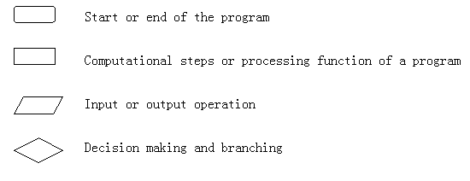
Flowcharts are usually drawn using some symbols; some standard symbols, which are frequently required for flowcharting many computer programs are shown below:

Slide 6
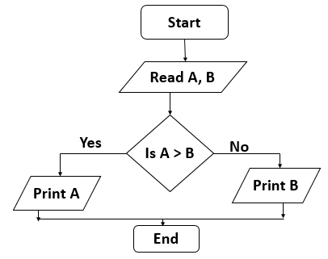
Example
Flow Chart to find largest of two numbers:

Slide 7
EXERCISE
Write following algorithms in the form of a flowcharts:
Even-Odd Number
Prime Number
Perfect Number
Armstrong Number
Factorial of a Number
Fibonacci Series
Prime Factor of a number

Slide 8
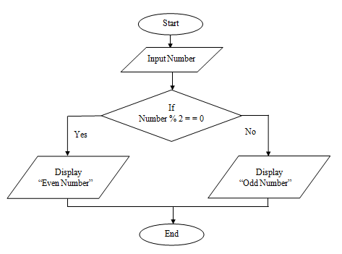
Even-Odd Number

Slide 9
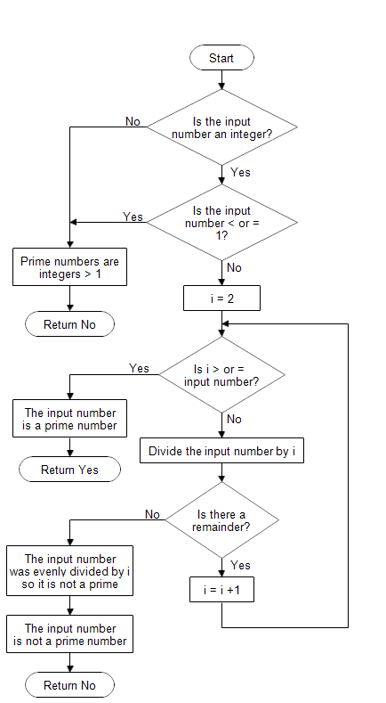
Prime Number

Slide 10
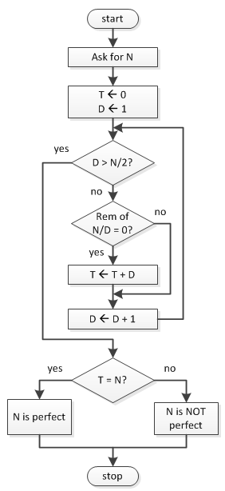
Perfect Number

Slide 11
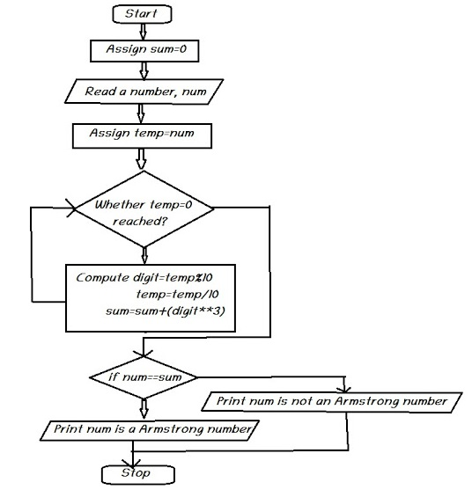
Armstrong Number

Slide 12
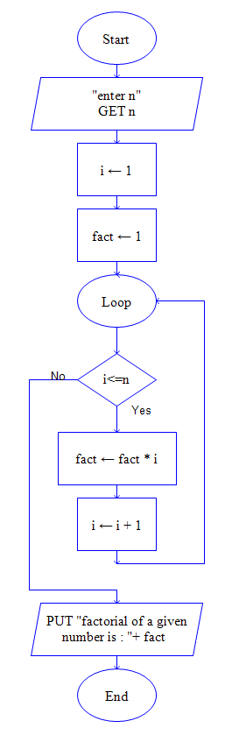
Factorial of a Number

Slide 13
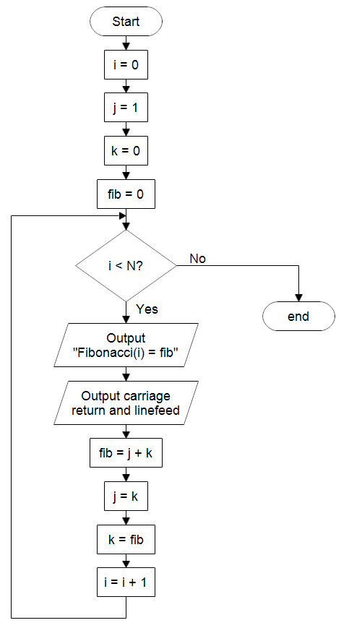
Fibonacci Series

Slide 14
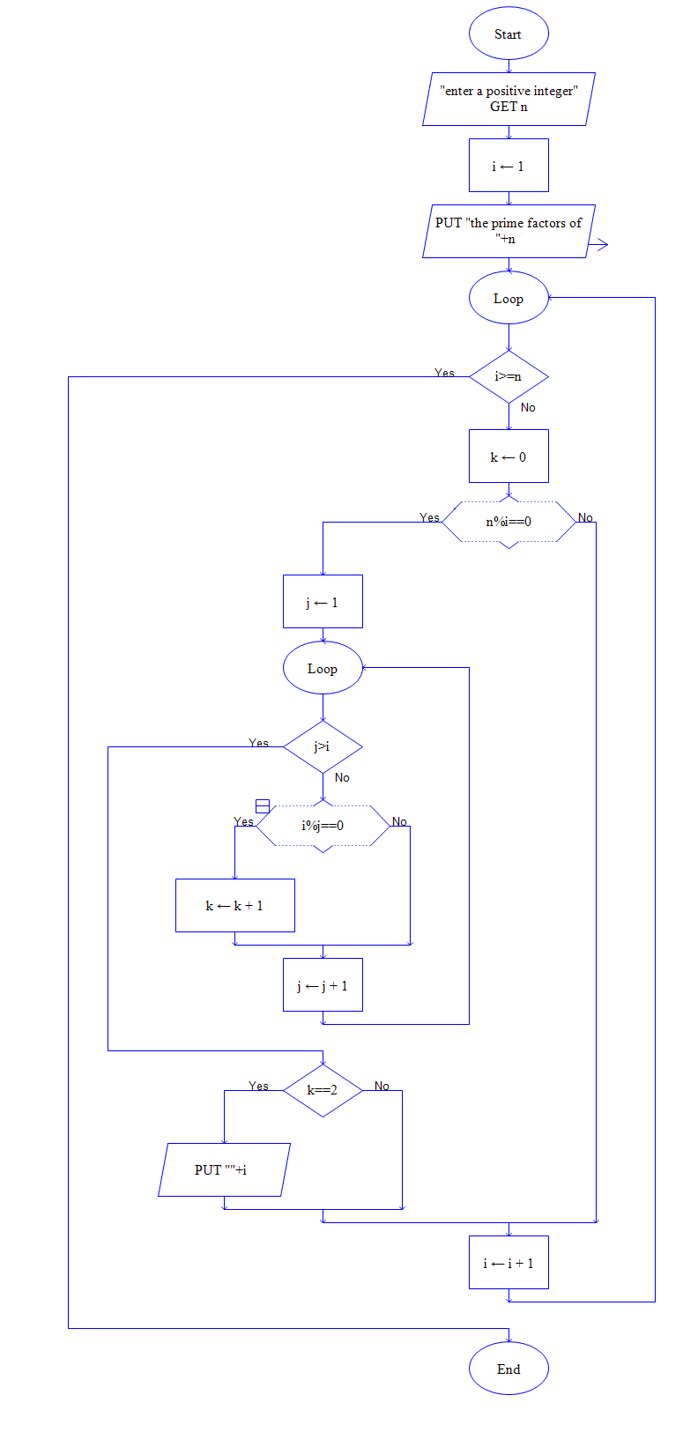
Prime Factor of a number

